Slide 1
AIM 222 - SQL for the Intermediate/Advanced User
Jeremy Fowler
5/22/19

Slide 2

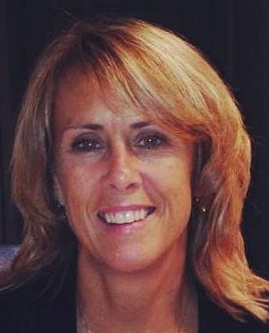
Presenters
Jeremy Fowler
Kristi Newlin
Sr. Technical Operations Architect
RT Specialty
Solution Consultant
Vertafore

Slide 3
SQL Refresher
The Four Basic SQL Statements
Clauses
Joins
Aliases

Slide 4
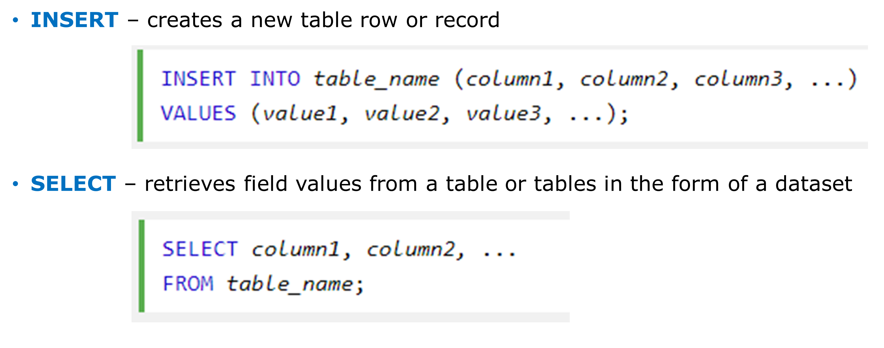
Basic SQL Statements

Slide 5
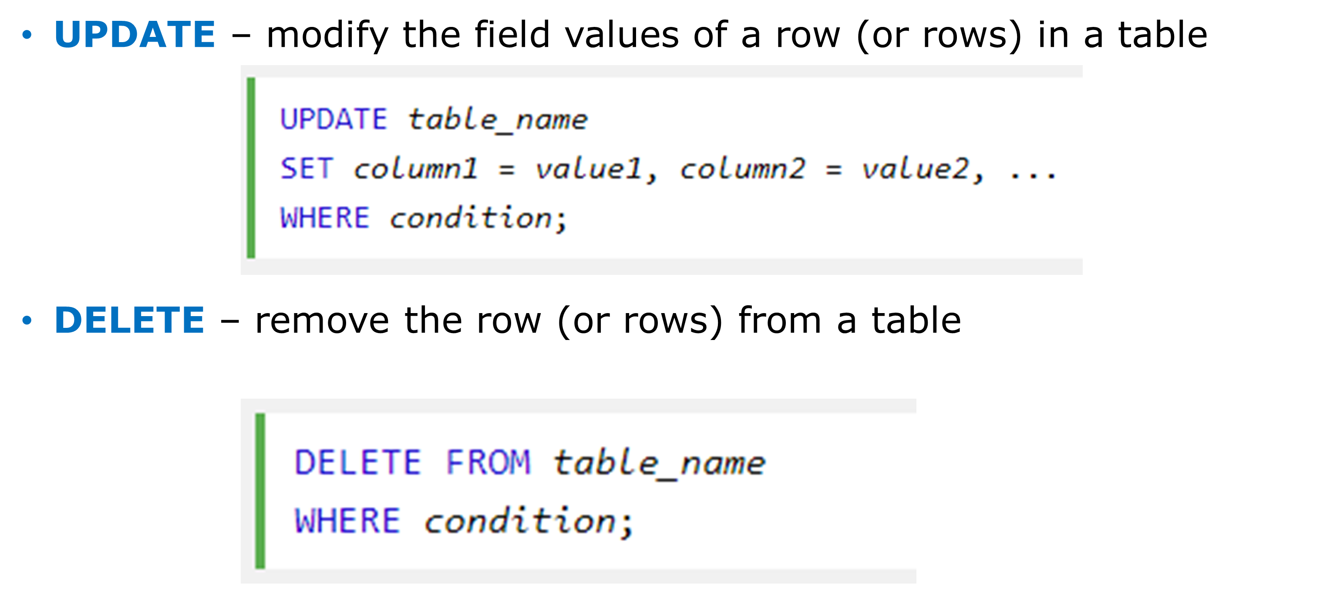
Basic SQL Statements

Slide 6
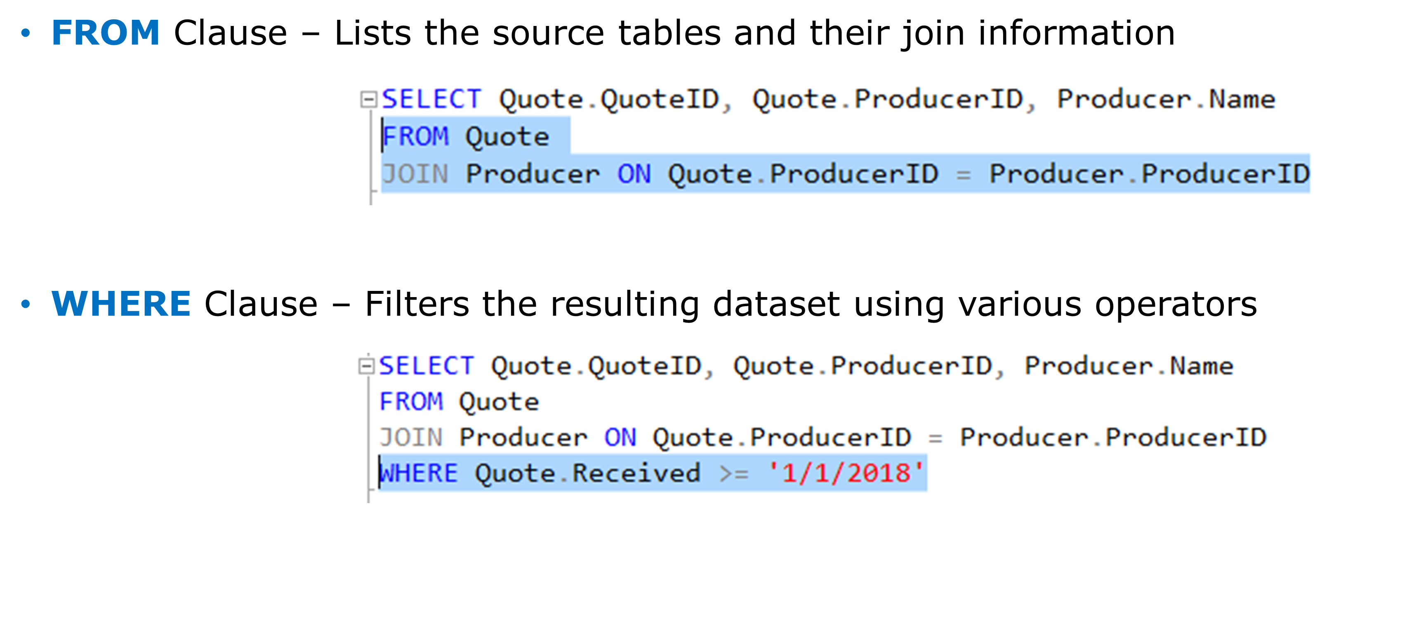
Clauses

Slide 7
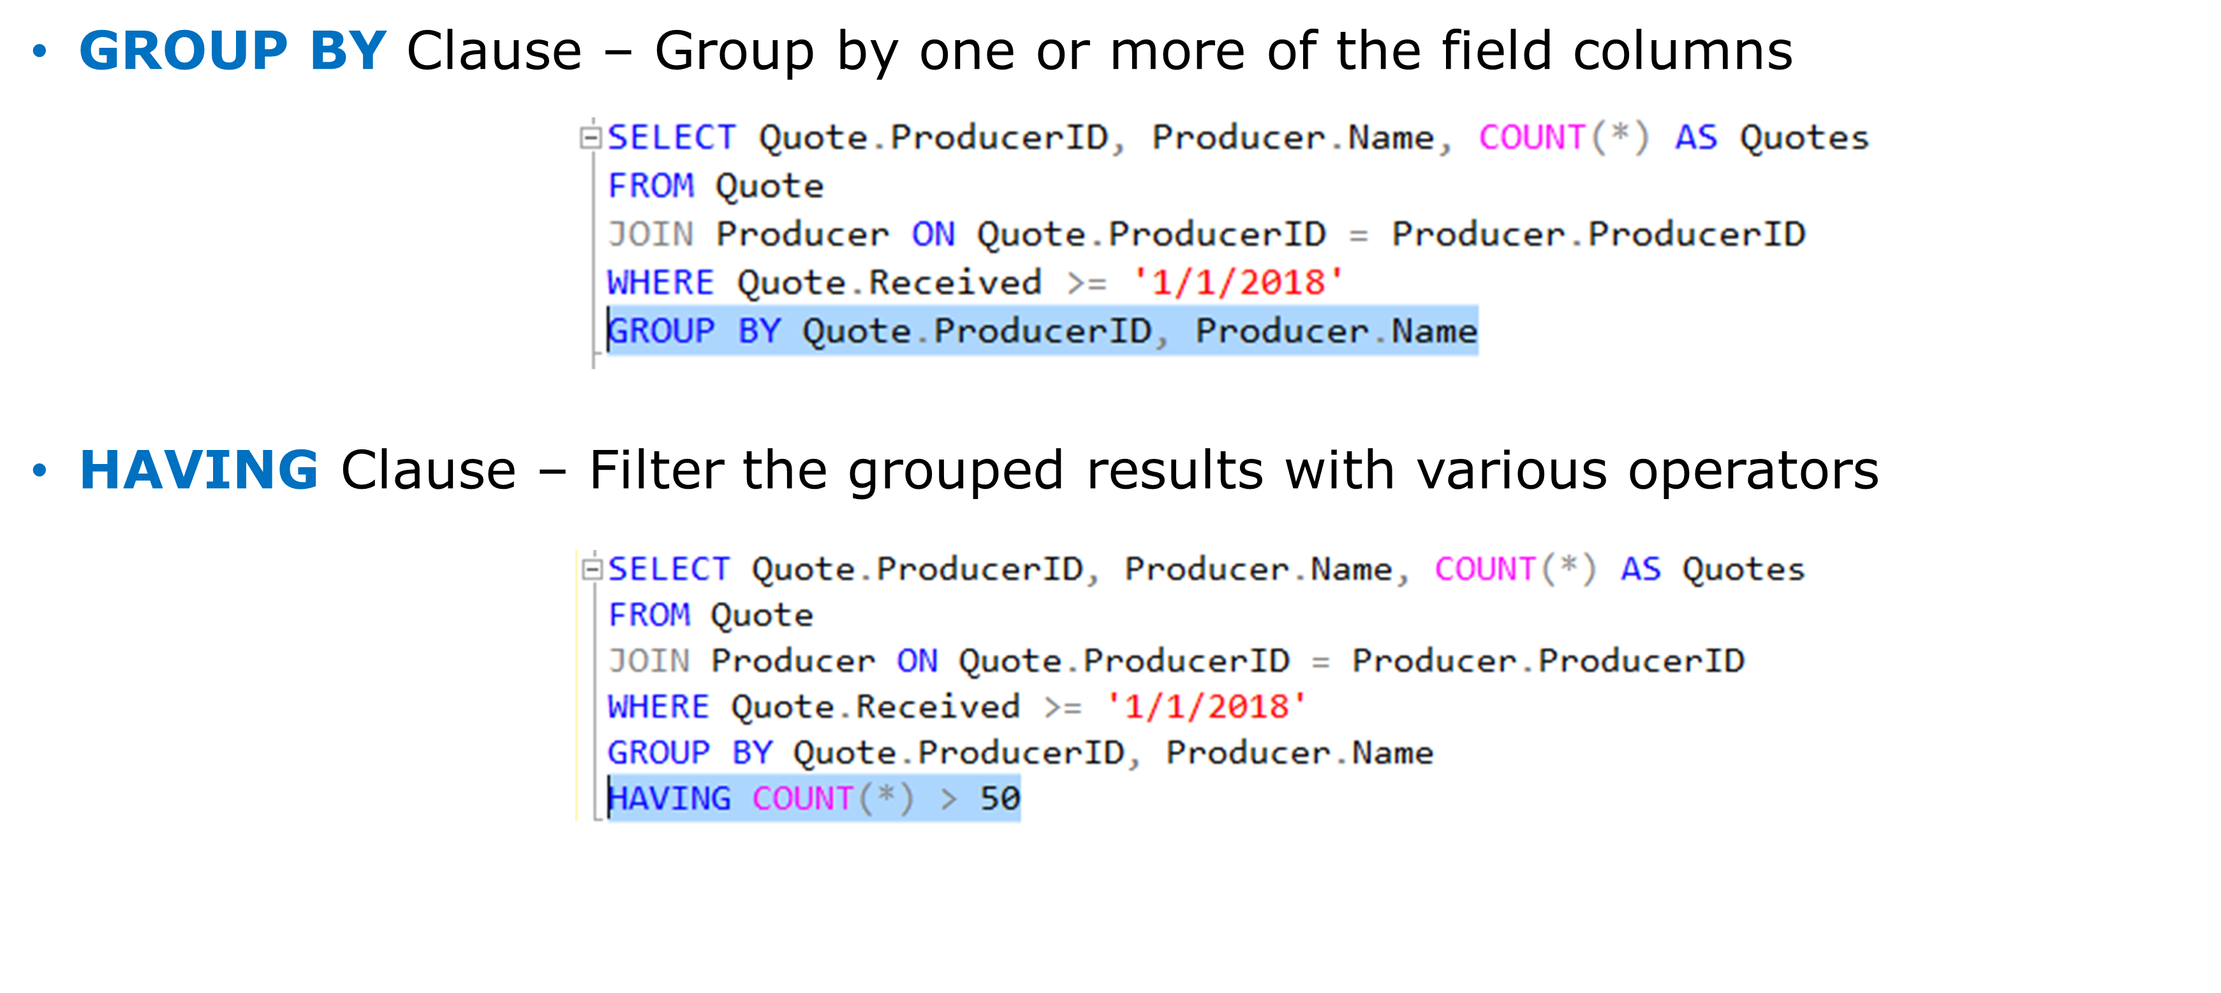
Clauses

Slide 8
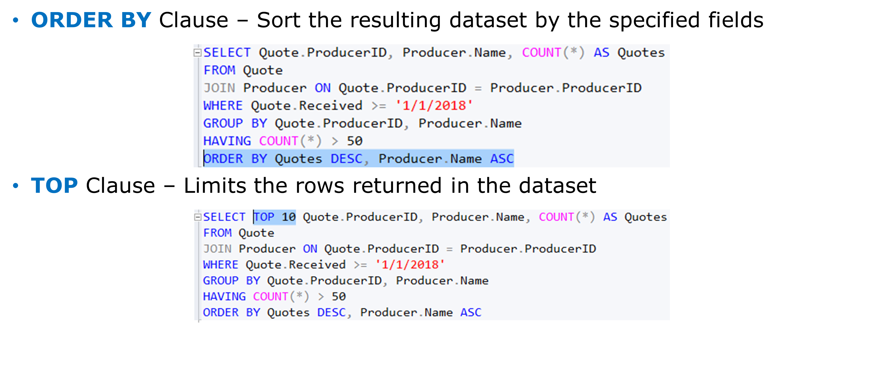
Clauses

Slide 9
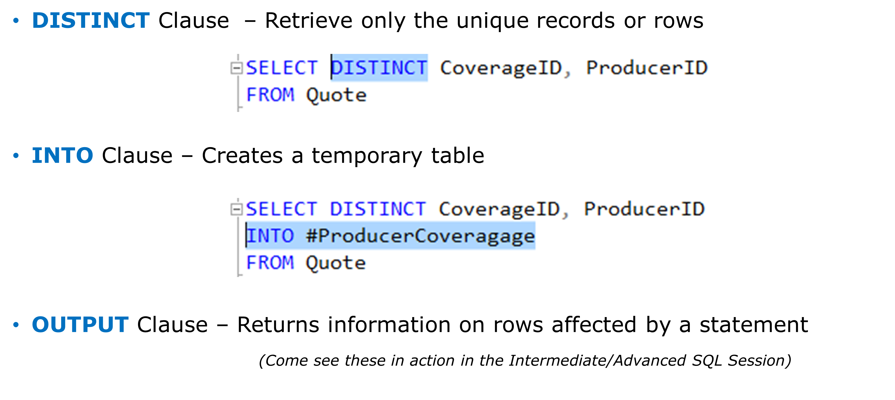
Clauses

Slide 10
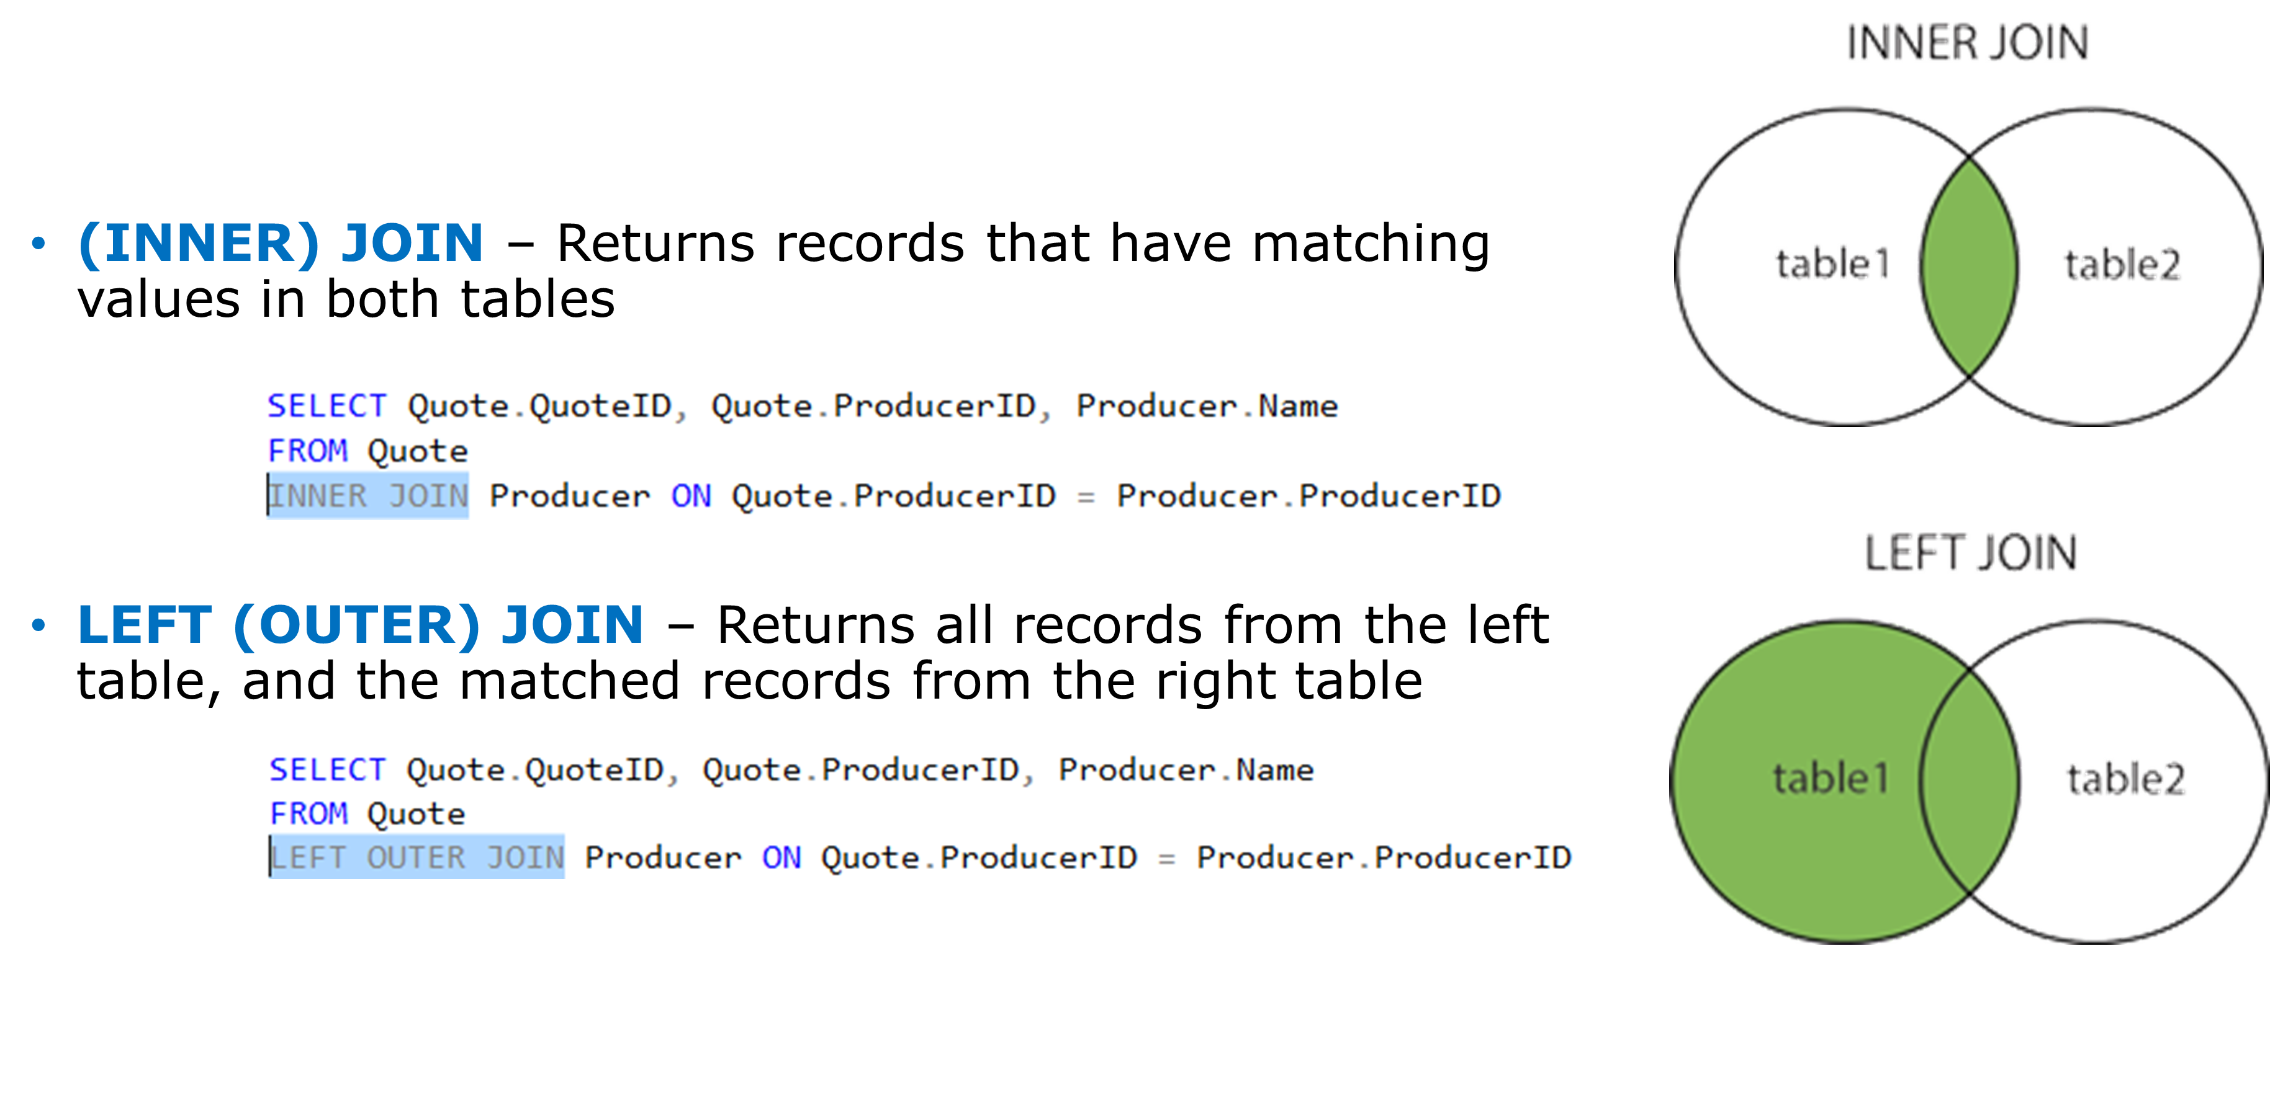
Joins

Slide 11
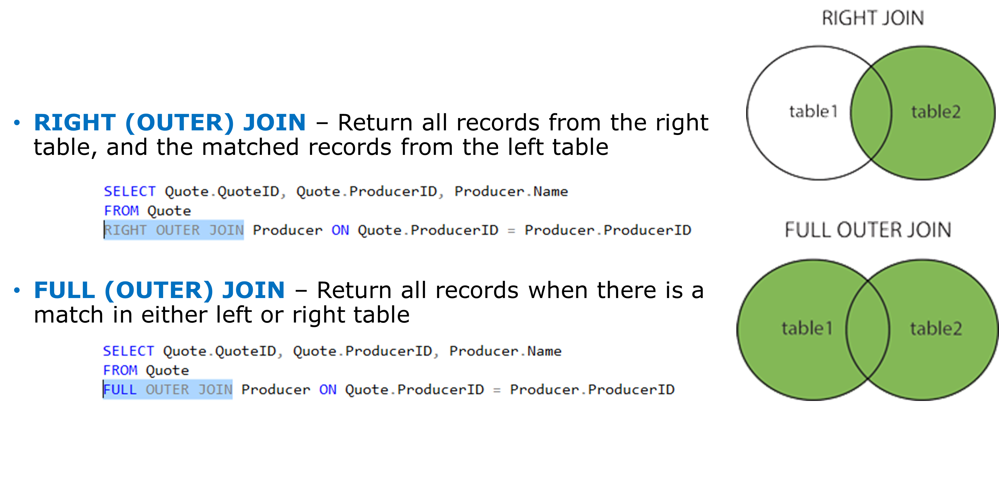
Joins

Slide 12
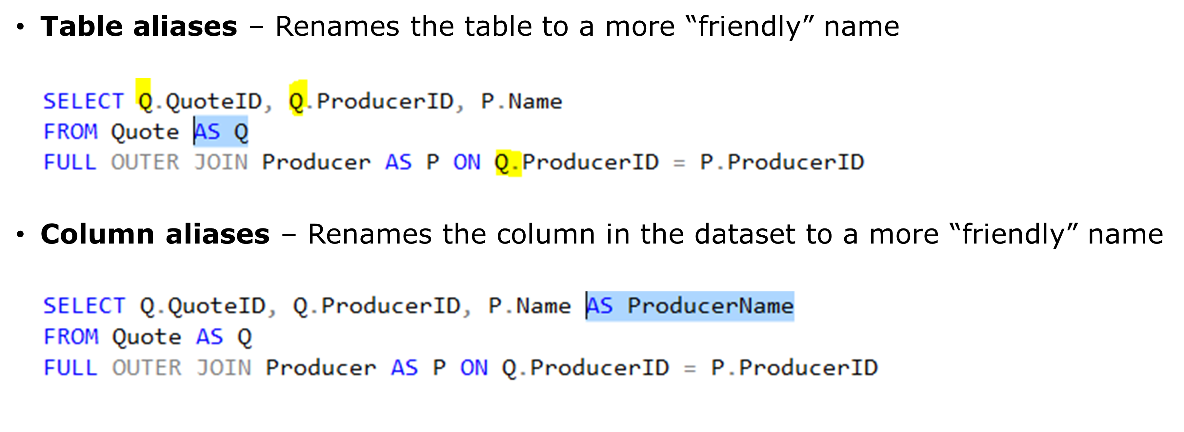
Aliases

Slide 13
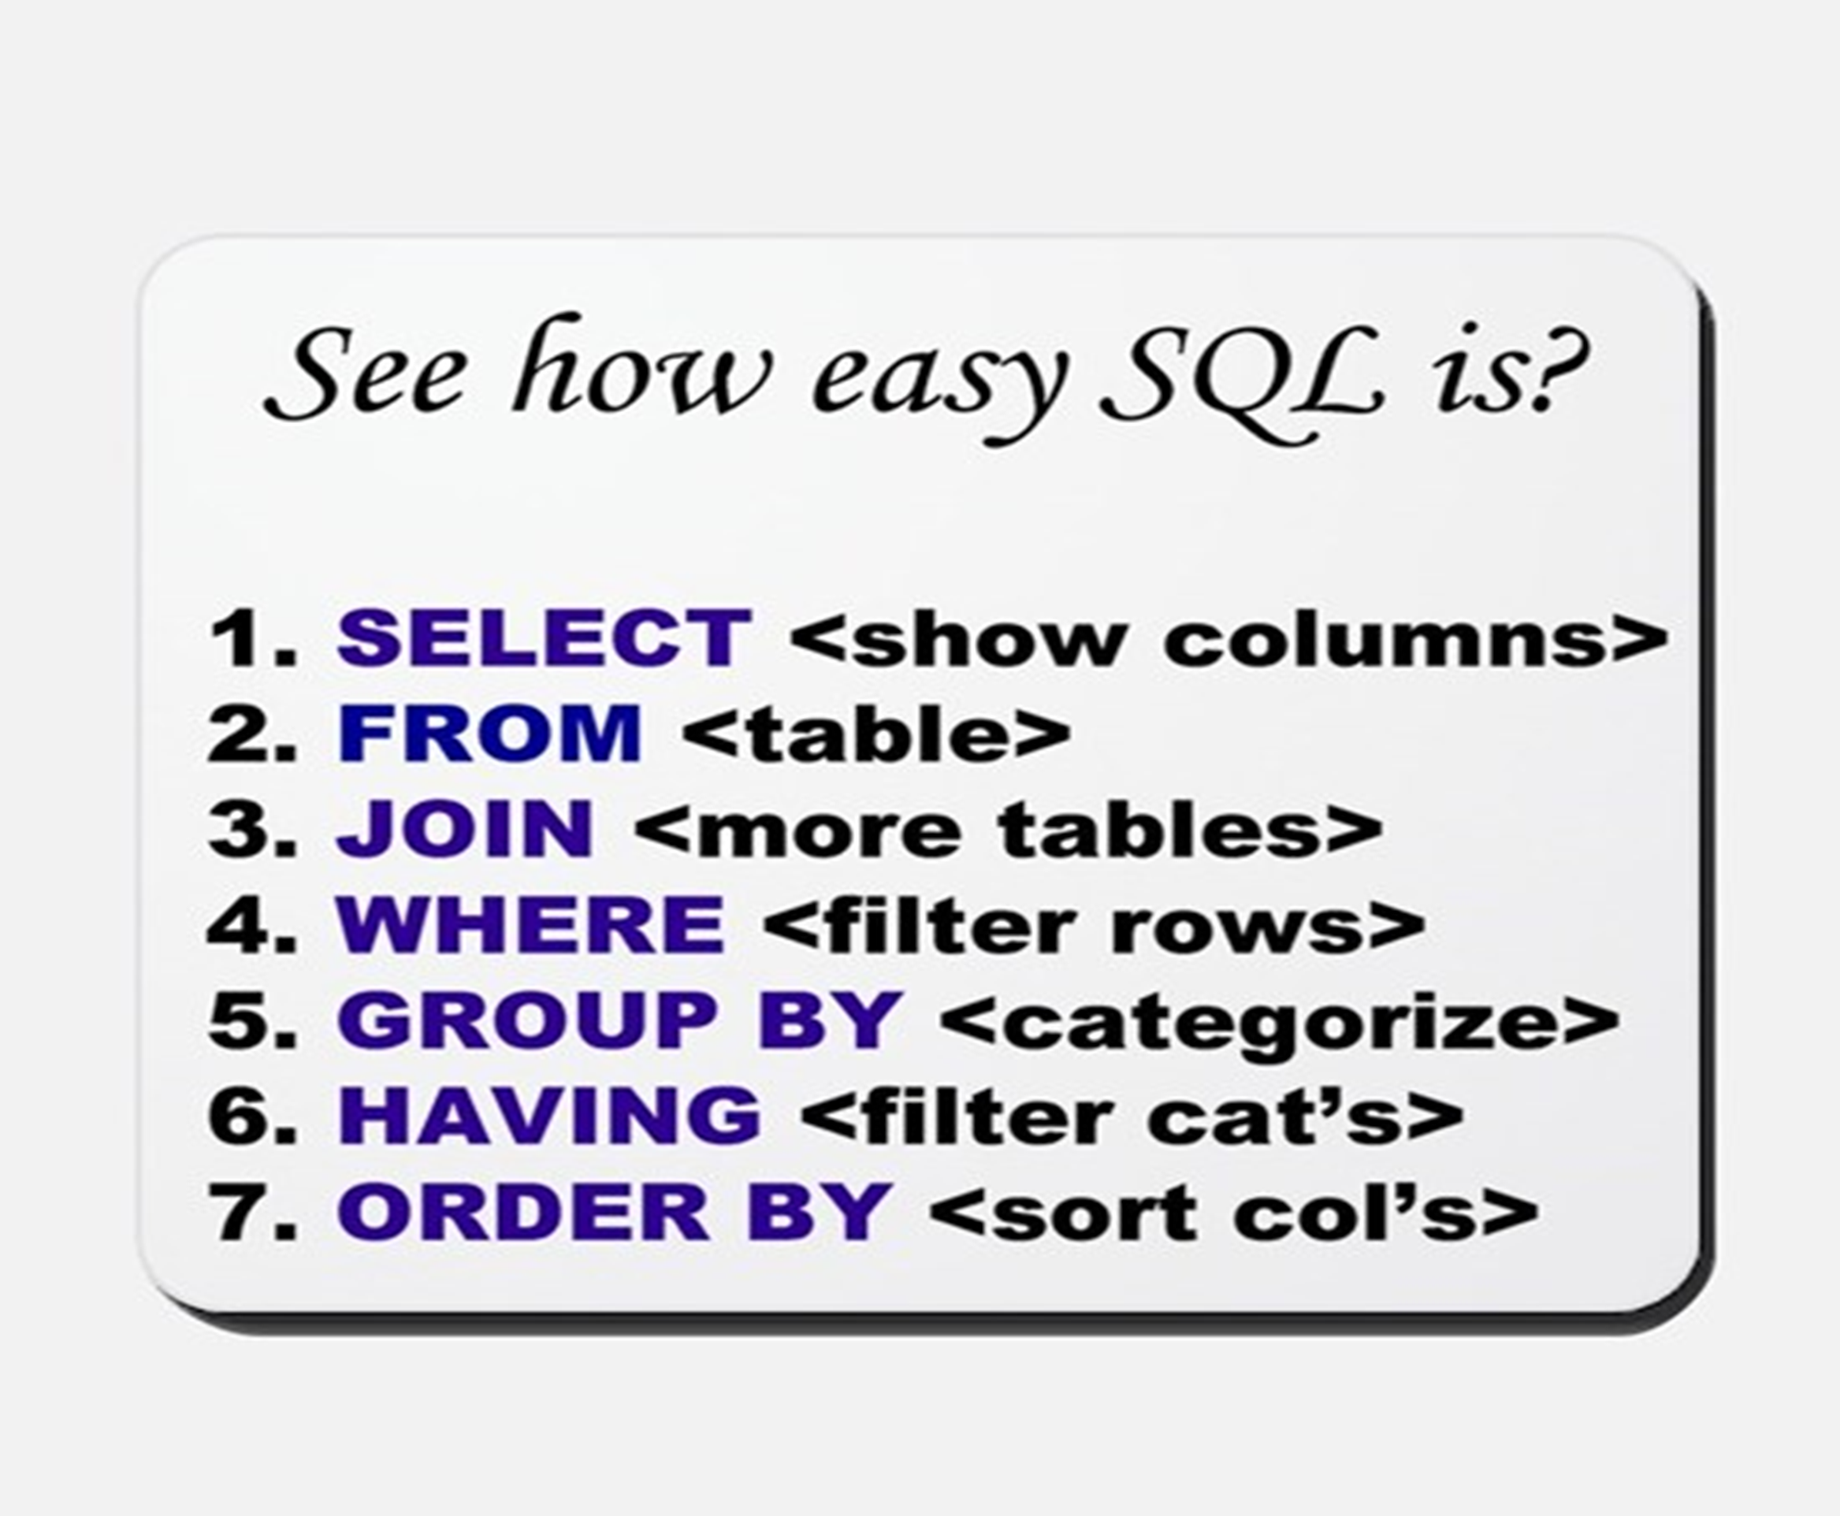
Statement Structure

Slide 14
Tools of the trade
SQL Server Management Studio (SSMS)
Azure Data Studio

Slide 15
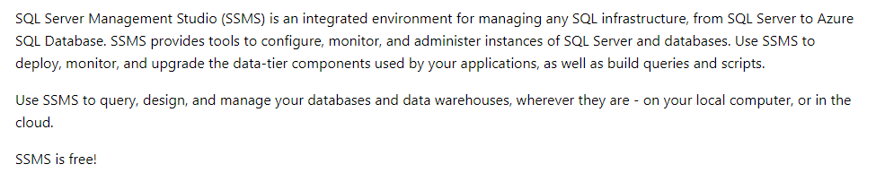
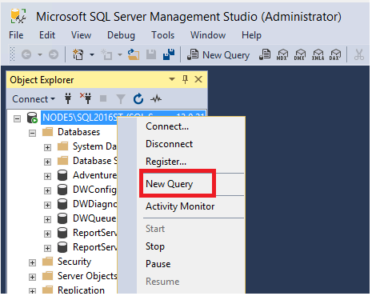
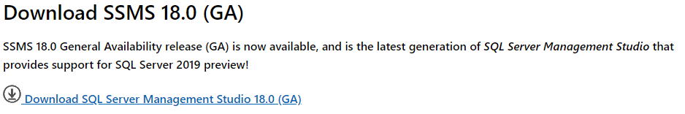
SQL Server Management Studio (SSMS)

Slide 16
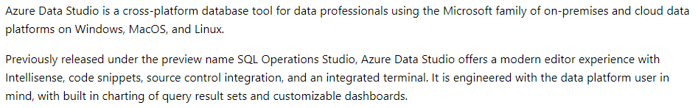
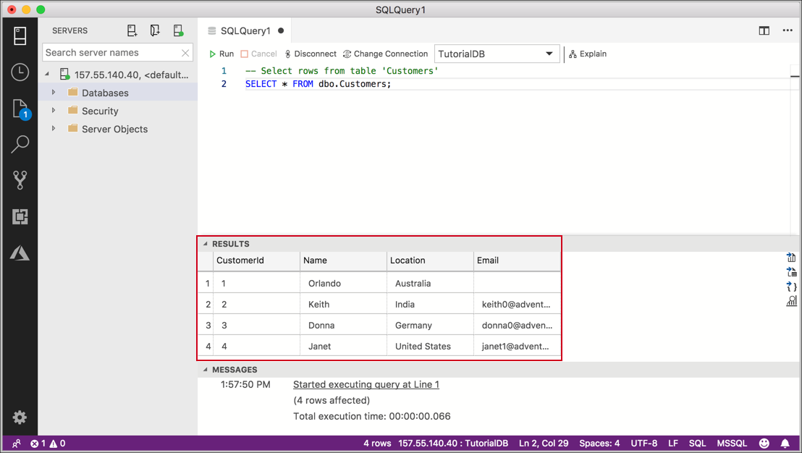
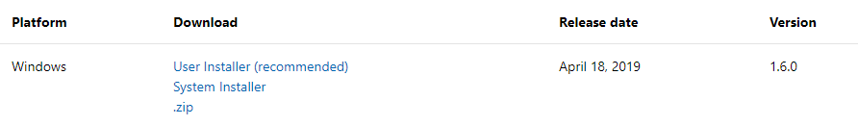
Azure Data Studio

Slide 17
Live Demo Time!

Slide 18
Questions?

Slide 19
Thank You

